Slide 1

Full Dependency
Partial Dependency
Partial Dependency

Slide 2
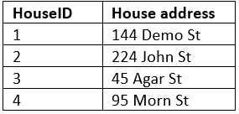
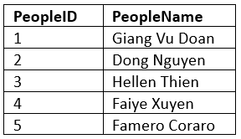
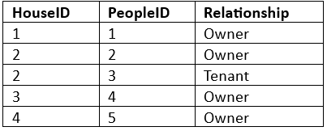
2NF

Slide 4

Partial Dependency
Transitive Dependency

Slide 5
Partial Dependency
Transitive Dependency

Slide 6



3NF

Slide 7
Partial Dependency

